Slide 1
SONG ANALYSIS
with Power BI
Presented by: Taufeeq Raji

Slide 2
Problem Statement
This internship project aims to conduct a comprehensive analysis of YouTube songs data using Power BI.
The goal is to utilize Power BI to create insightful visualizations and reports that provide a deeper understanding of YouTube songs' performance, popularity, and user engagement.
The analysis aims to uncover trends, preferences, and patterns in the data to aid content creators and stakeholders in optimizing their YouTube song content.

Slide 3
Dataset Description
1. video_id: Unique identifier for each YouTube video.
2. channelTitle: Title of the YouTube channel publishing the song.
3. title: Title of the YouTube song video.
4. description: Description provided for the YouTube song video.
5. tags: Tags associated with the YouTube song video.
6. publishedAt: Date and time when the YouTube song video was published
7. viewCount: Number of views received by the YouTube song video.
8. likeCount: Number of likes received by the YouTube song video.
9. favoriteCount: Number of times the YouTube song video has been marked as a favorite.
10. commentCount: Number of comments posted on the YouTube song video.
11. duration: Duration of the YouTube song video.
12. definition: Video definition or quality (e.g., HD, SD).
13. caption: Availability of captions for the YouTube song video

Slide 4
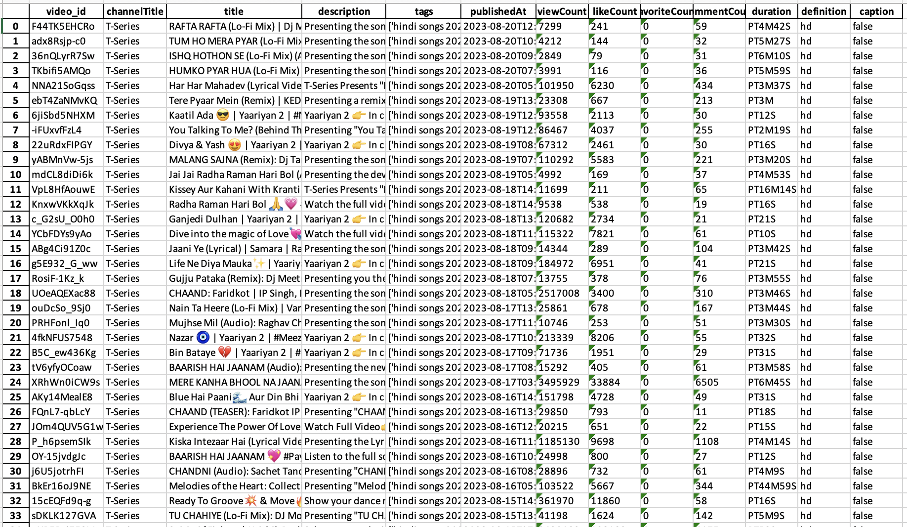

Slide 5
Project Objectives
1. Data Cleaning and Preparation:
Clean and preprocess the dataset, handling missing values or outliers.
Convert relevant columns to appropriate data types.
2. Exploratory Data Analysis (EDA):
Explore patterns and distributions in view counts, like counts, and comments.
Identify trends in the popularity and engagement of YouTube song videos.

Slide 6
3. Content and Channel Analysis:
Analyze the distribution of videos across different channels.
Identify popular tags and their correlation with view counts.
4. Temporal Trends:
Explore how YouTube song video metrics vary over time.
Identify peak publishing times and their impact on engagement.
5. User Engagement Insights:
Investigate relationships between likes, comments, and views.
Identify factors influencing user engagement with YouTube song videos.

Slide 7
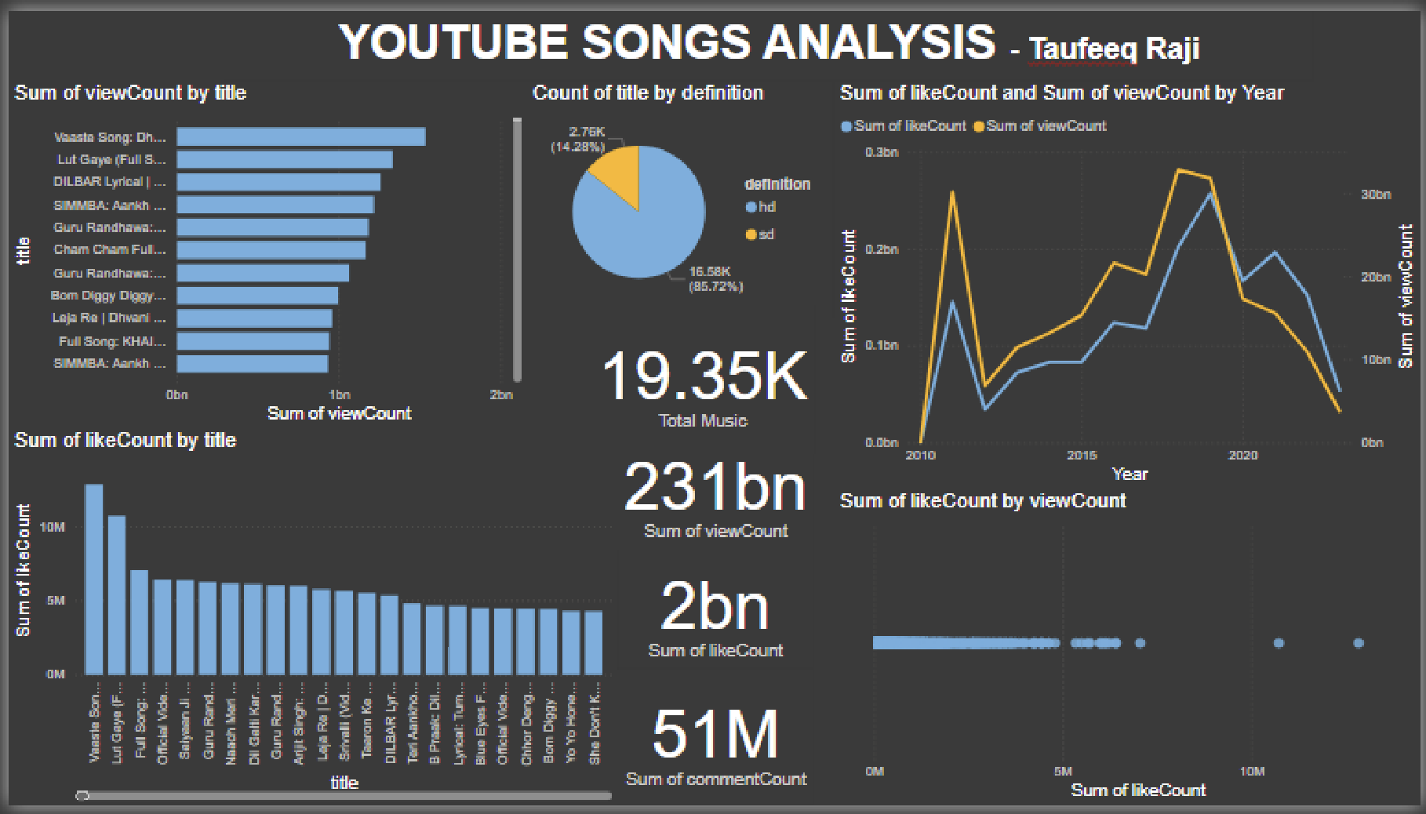
EXAMPLE DASHBOARD

Slide 8
Recommendations for content creators and stakeholders to enhance YouTube song video performance
Optimize titles & descriptions with keywords.
Use relevant as well as a variety of tags for search visibility.
Engage viewers through discussions and comments by replying to them.
Publish at optimal times and maintain a consistent publishing schedule.
Analyze metrics and trends regularly to understand what type of content performs best and investigate the relationship between likes, comments and view.
Collaborate with other YouTube channels to cross-promote videos for larger reach.
Offer a variety of content such as behind-the-scenes, live performances, and interviews to keep the audience engaged.

